Slide 1
DIABETES
RECOGNITION
Presented BY
NISHMITHA

Slide 2
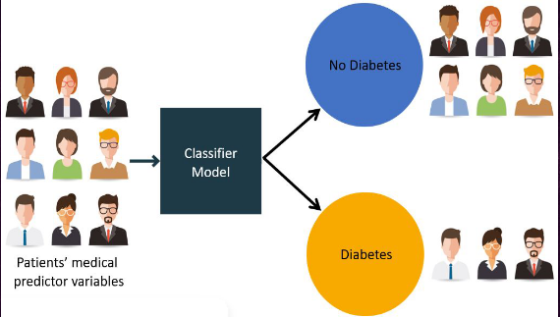

Slide 3
PRESENTATION FLOW
Project objective
Dataset sample
Steps involved
Block diagram
Conclusion

Slide 4
PROJECT OBJECTIVE
Prepare the data-set set using several methods to train the model.
Build a model which can give high accuracy of predicting the disease

Slide 5
DATASET SAMPLE
Pregnancies | Glucose | blood pressure | skin thickness | Insulin | BMI | DPF | Age | Outcome
6 | 148 | 72 | 35 | 0 | 33.6 | 0.627 | 50 | 1
1 | 85 | 66 | 29 | 0 | 26.6 | 0.351 | 31 | 0
8 | 183 | 64 | 0 | 0 | 23.3 | 0.672 | 32 | 1
1 | 89 | 66 | 23 | 94 | 28.1 | 0.167 | 21 | 0
0 | 137 | 40 | 35 | 168 | 43.1 | 2.288 | 33 | 1
5 | 116 | 74 | 0 | 0 | 25.6 | 0.201 | 30 | 0
3 | 78 | 50 | 32 | 88 | 31 | 0.248 | 26 | 1
10 | 115 | 0 | 0 | 0 | 35.3 | 0.134 | 29 | 0
2 | 197 | 70 | 45 | 543 | 30.5 | 0.158 | 53 | 1
8 | 125 | 96 | 0 | 0 | 0 | 0.232 | 54 | 1

Slide 6
STEPS INVOLVED
Importing dataset
Analyze the dataset
Splitting up of data
Applying ML algorithm
Evaluation of model

Slide 7
IMPORTING DATASET
The basic process of loading data from a CSV file into a pandas data frame is achieved using the “read_csv” function in pandas as pd .read csv(“Filename.csv”)
2. ANALYSING DATASET
Basically we need to analyze the and remove the columns which are not necessary and use the ones which are necessary and handle the missing value if any

Slide 8
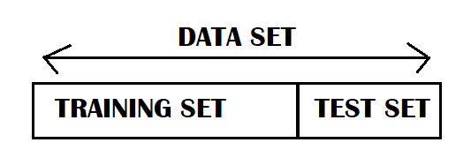
3. SPLITTING UP OF DATA
Requirements:
Import train _test_ spilt from sklearn .model_selection
Data is splitted into Training and Testing set based on size of the

Slide 9
4. APPLYING ML ALGORITHM
Classification is the process of predicting the class of given data points . Classification predictive modeling is the task of approximating a mapping function(F) from input variables(X) to discrete output variables(Y).
>Linear classifiers : Logistic regression
>Nearest neighbor
>Random forest.

Slide 10
5.EVALUATION OF MODEL
Accuracy is a common evaluation metric for classification problems . It’s the number of correct predictions made as a ratio of all predictions made.
REQUIREMENTS:
>Import accuracy_score from sklearn.metrics

Slide 11
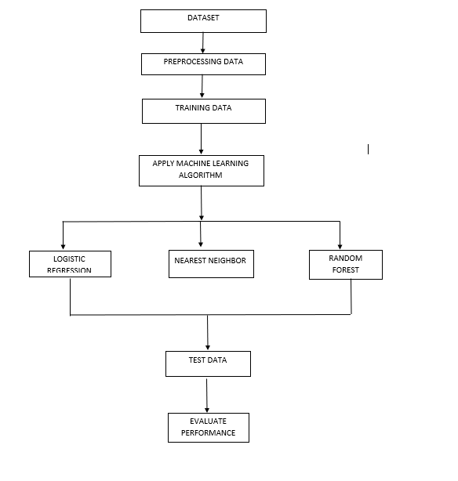
BLOCK DIAGRAM

Slide 12
CONCLUSION
The machine learning methods can support the doctors to identify and cure diabetic diseases.
We shall conclude that the improvement in classification accuracy helps to make the machine learning models get better results.
The performance analysis is in terms of accuracy rate among all the classification techniques such as decision tree, logistic regression, k-nearest neighbours, naive bayes, and SVM , random forest , adaboost , xg boost.
In future, if we get a large set of diabetic datasets, we can perform comparative analysis for analysing the performance of each algorithm as well as the Hybrid algorithm so that the best one can be applied for predictive analysis.

Slide 13
THANK YOU

